Slide 1
Serving Machine Learning Models with MXNet Model Server
Sergey Sokolov
©2018 Amazon Web Services, Inc. or its affiliates, All rights reserved

Slide 2
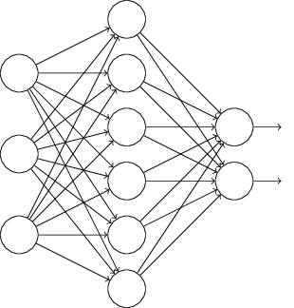
What does a deployed model looks like?
Model
Mobile
Internet
Model Server
Desktop
IoT

Slide 3
The Undifferentiated Heavy Lifting of Model Serving
Performance
Networking
Monitoring
Model Decoupling
Cross Framework
Cross Platform
Availability

Slide 4

MXNet Model Server
Machine learning model server
Serves MXNet and ONNX models
Automated HTTP endpoints setup
Auto-scales to all available CPUs and GPUs
Pre-built and configured containers
CLI to package model artifacts for serving
Open source project under AWS Labs
https://github.com/awslabs/mxnet-model-server

Slide 5
It’s Demo Time!
https://github.com/awslabs/mxnet-model-server#quick-start

Slide 6





REST and OpenAPI
Model Archive
Containerization
ONNX Support
Operational Metrics

Slide 7
Model Archive
Trained Network
Model Signature
Model Archive
Model Export CLI
Custom Code
Auxiliary Assets

Slide 8
It’s Demo Time!
https://github.com/awslabs/mxnet-model-server/blob/master/model-archiver/README.md

Slide 9
REST and OpenAPI
REST-like endpoint: /predictions/<model-name>
Endpoint auto-generated from the model’s signature.json
JSON encoding by default
Binary input via request payload
OpenAPI support – client code-gen and tooling
curl http://localhost:8080/api-description

Slide 10
Containerization
Production-ready orchestration tools: ECS, Docker, Kubernetes
Easy to scale out
Robust and scalable images
Automatically leverages all GPUs and CPUs on host
Pre-configured images on DockerHub: awsdeeplearningteam/mms_cpu

Slide 11
Containerization
Container Cluster
MMS Container
MMS Container
MMS Container
MXNet Model Server
Load Balancer
MXNet
NGINX
Pull or Build
Run
MMS Docker Image

Slide 12
Demo: Containers
https://github.com/awslabs/mxnet-model-server/blob/master/docker/README.md#quickstart

Slide 13
Operational Metrics
Metrics
Requests
Dimensions
Model Name
Latencies
Resources
Target
Log / CSV
AWS CloudWatch
Host Name

Slide 14
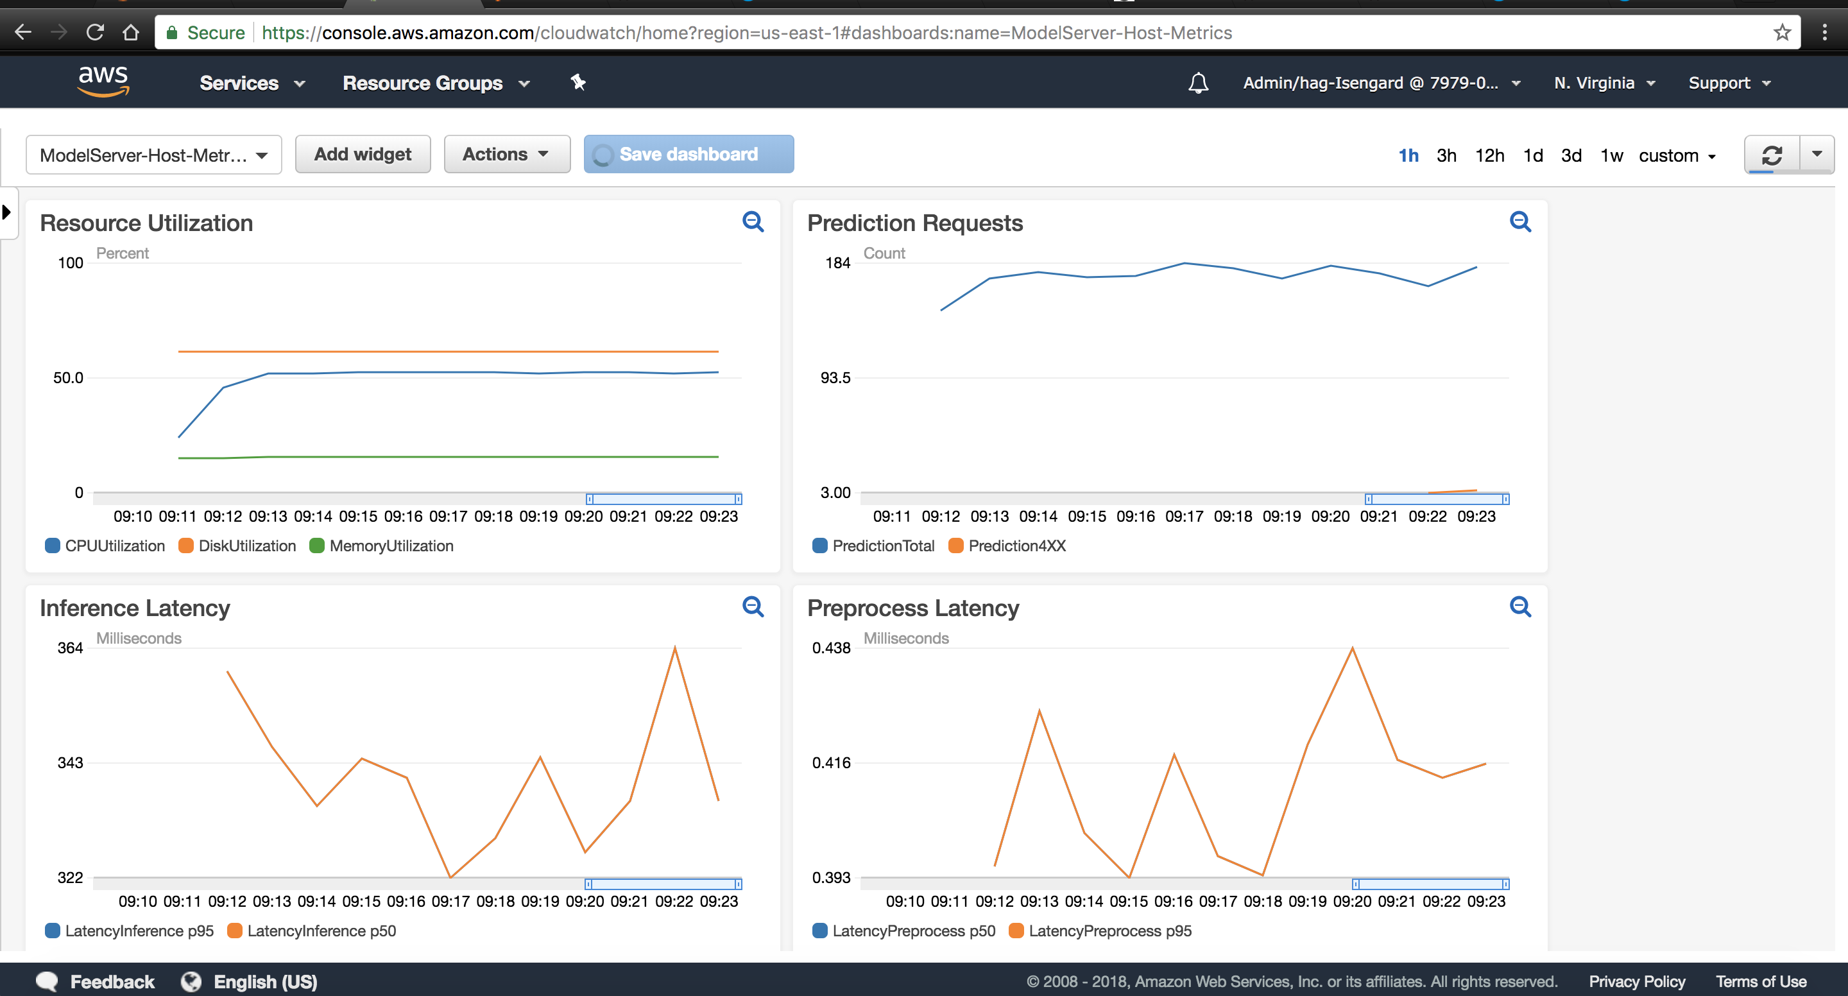

Slide 15

ONNX Support
O(n²)
Pairs
MXNet
CoreML
Caffe2
PyTorch
TF
CNTK
TensorRT
NGraph
SNPE
Many Frameworks
Many Platforms
ONNX: Common IR
Supported in MMS

Slide 16

Serverless Model Serving
+
MXNet Model Server
AWS Fargate

Slide 17
AWS Fargate
Deploy containers without managing hosts or clusters
Seamless scaling
Pay only for CPU and Memory consumed
https://github.com/awslabs/mxnet-model-server/blob/master/docs/mms_on_fargate.md
Back

Slide 18

Serverless Model Serving Architecture
VPC
ECS Cluster and Service
Internet
Load Balancer
Fargate Task(s)
MMS Container
Model
Server
CloudWatch

Slide 19
Recommended deployment
MMS doesn't provide authentication. You have to have your own authentication proxy in front of MMS.
MMS doesn't provide throttling, it's vulnerable to DDoS attack. It's recommended to running MMS behind a firewall.
Enable SSL (disabled by default)
Run inside Docker container

Slide 20
Try it out, Star and Contribute!
https://github.com/awslabs/mxnet-model-server

